Slide 1
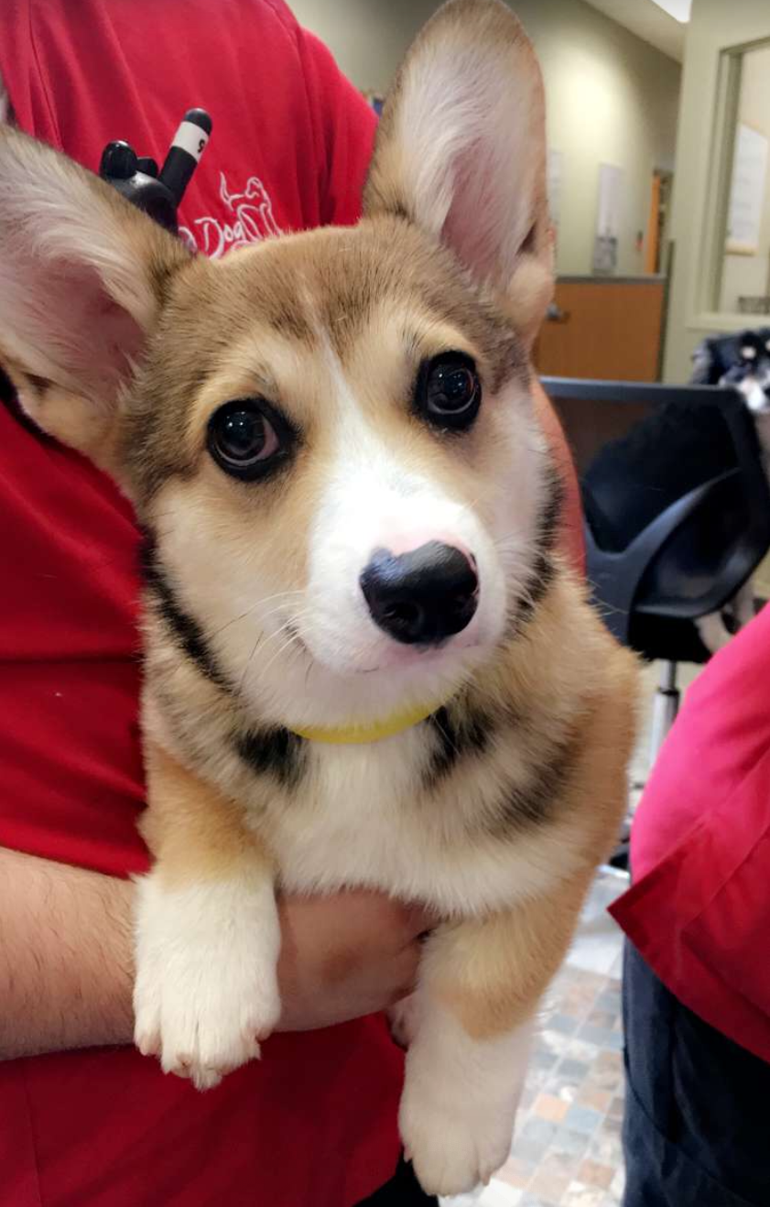
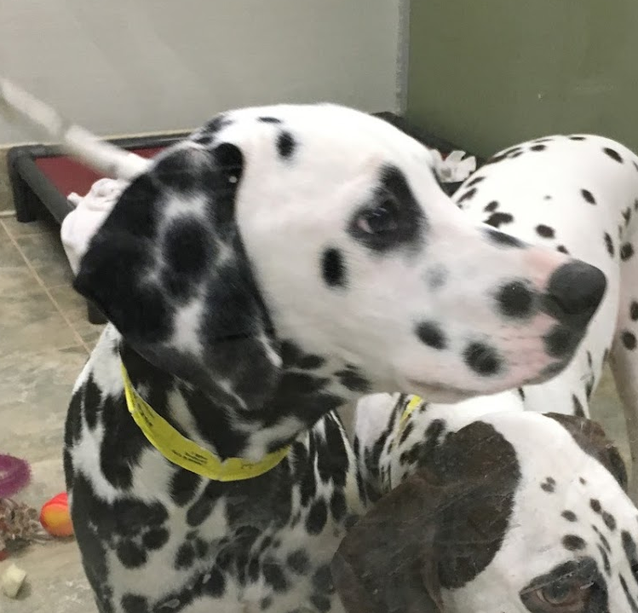


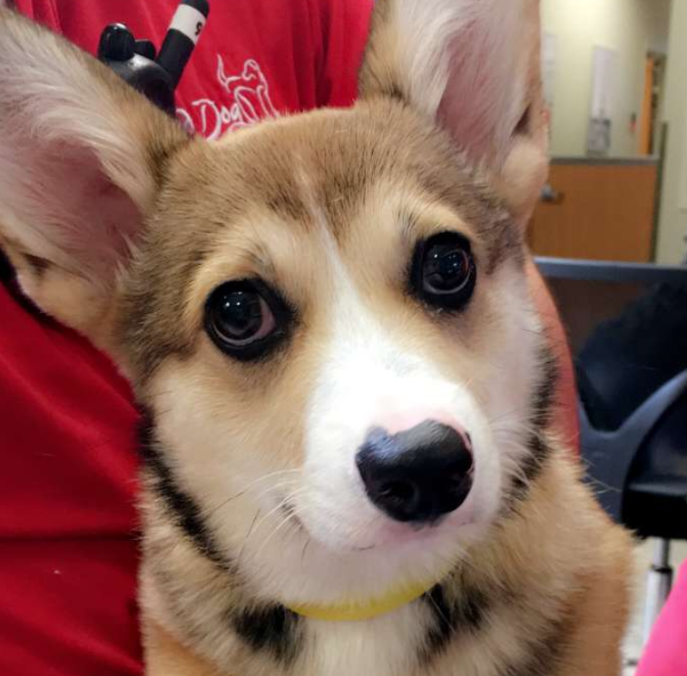
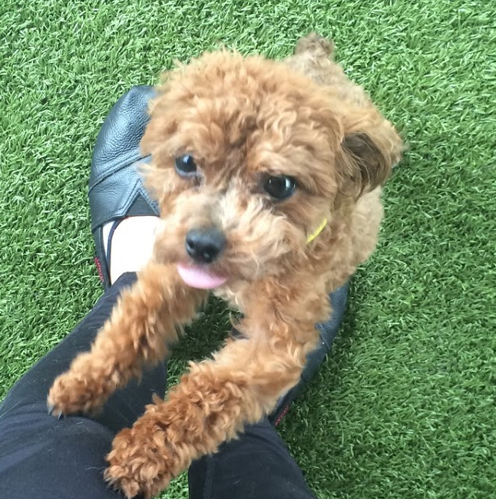
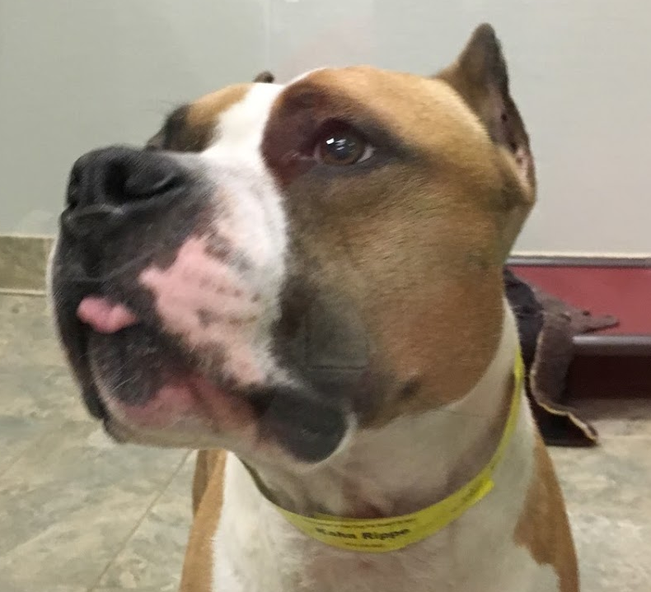
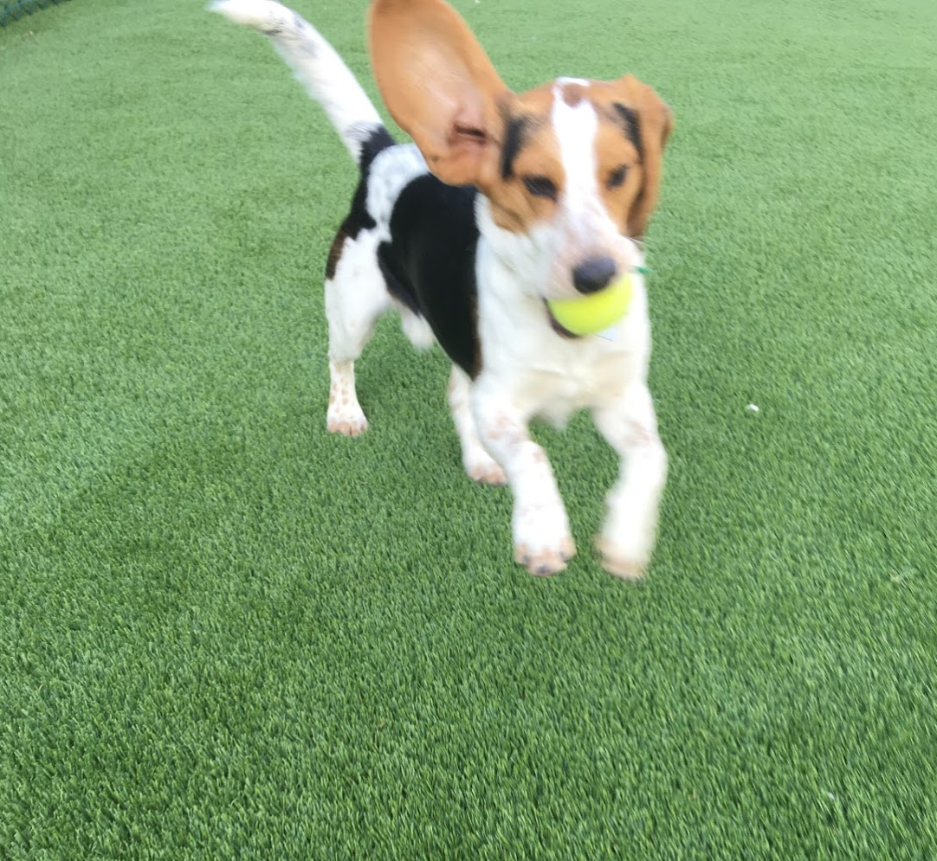
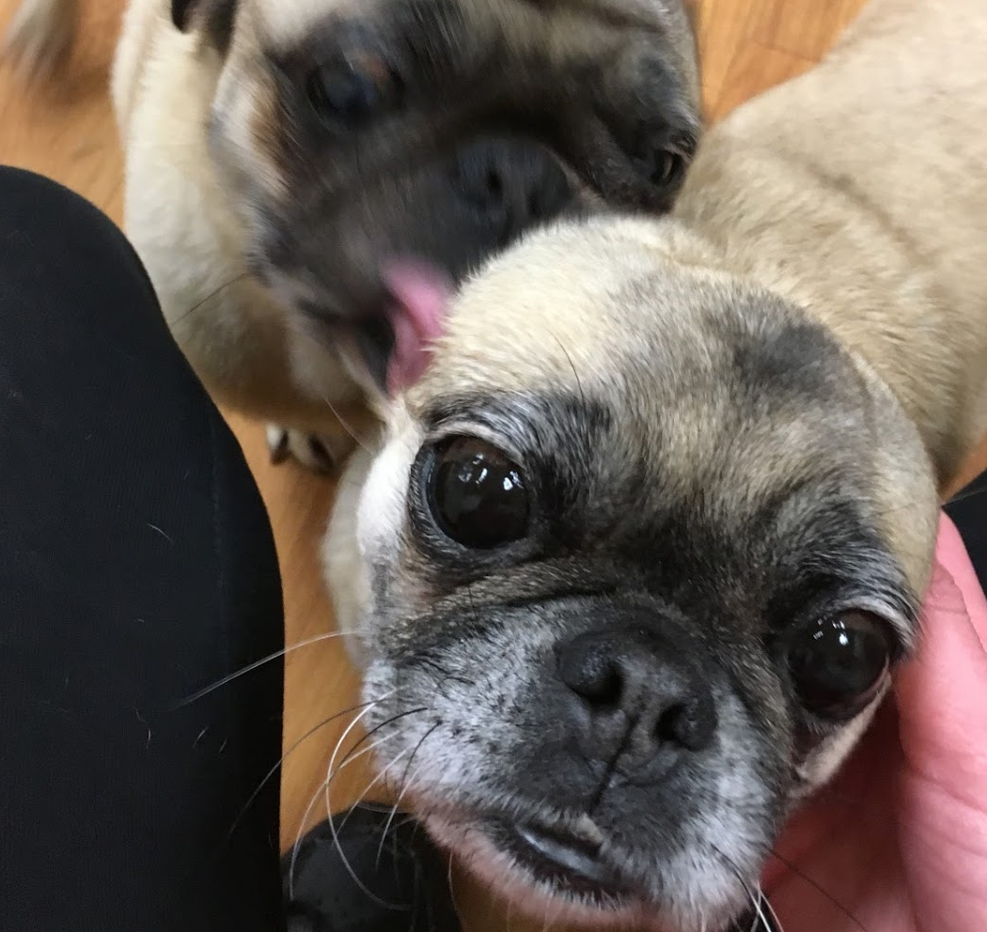

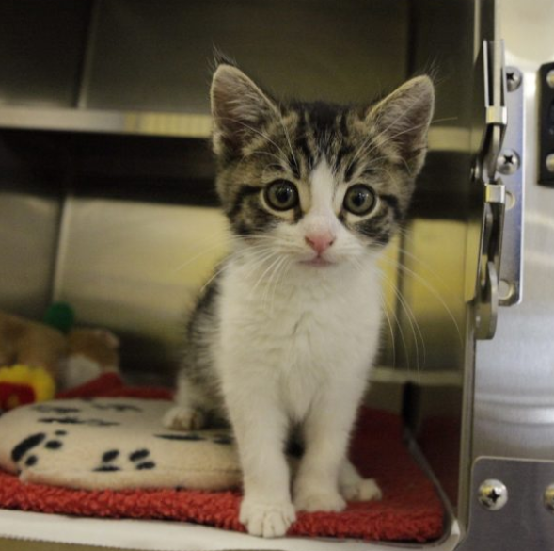
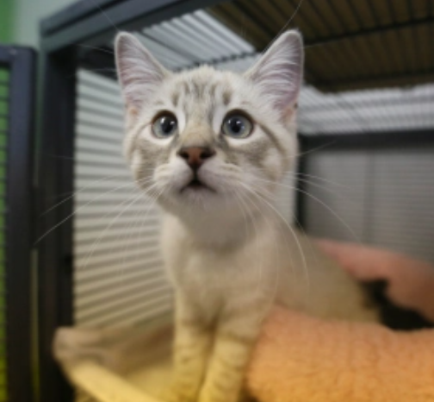
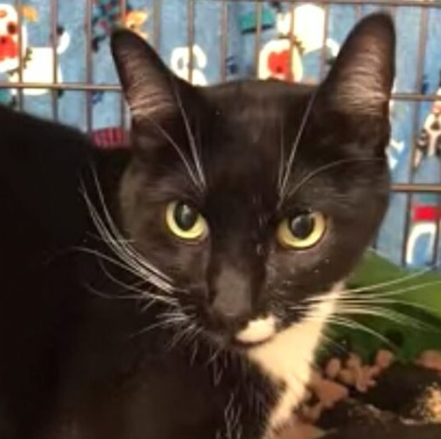
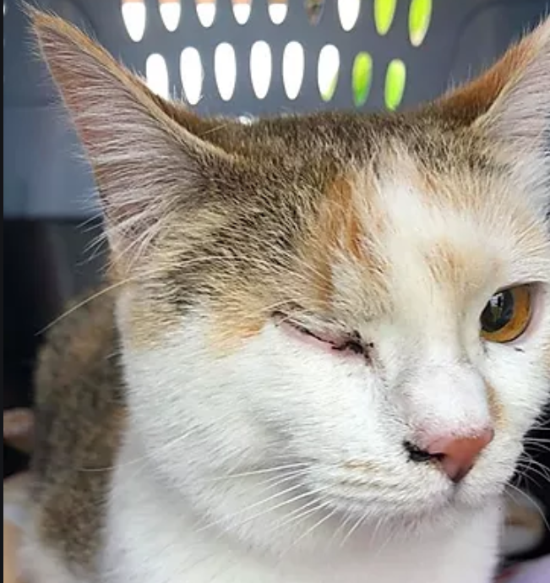
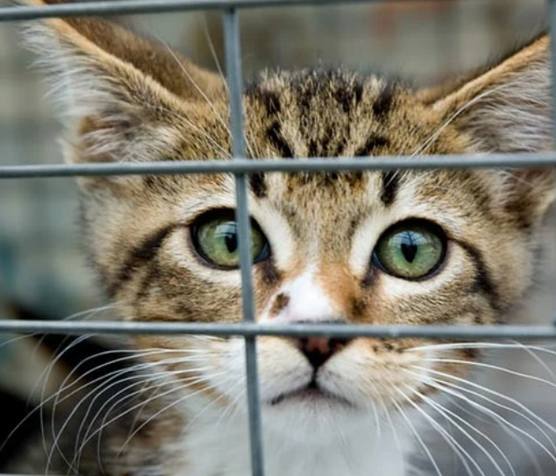
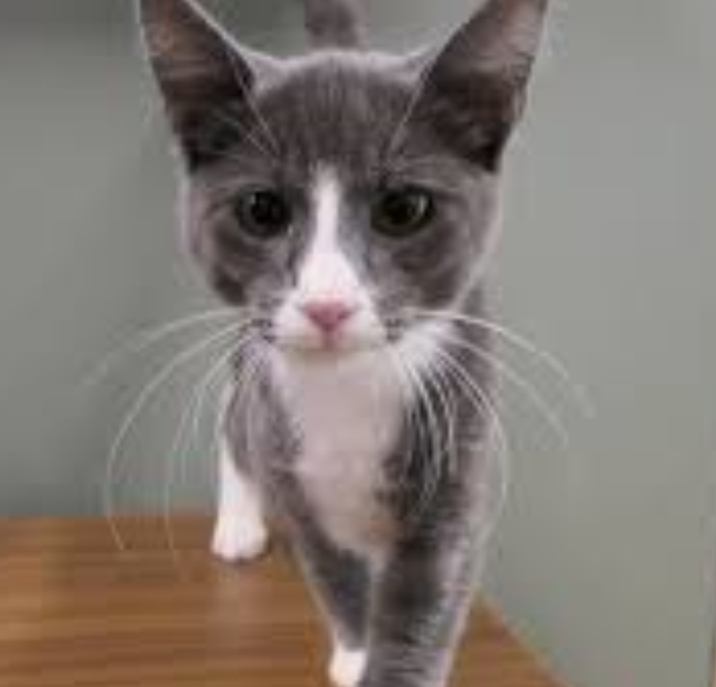

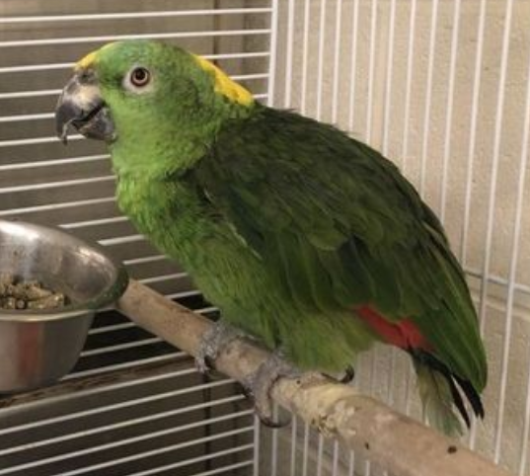
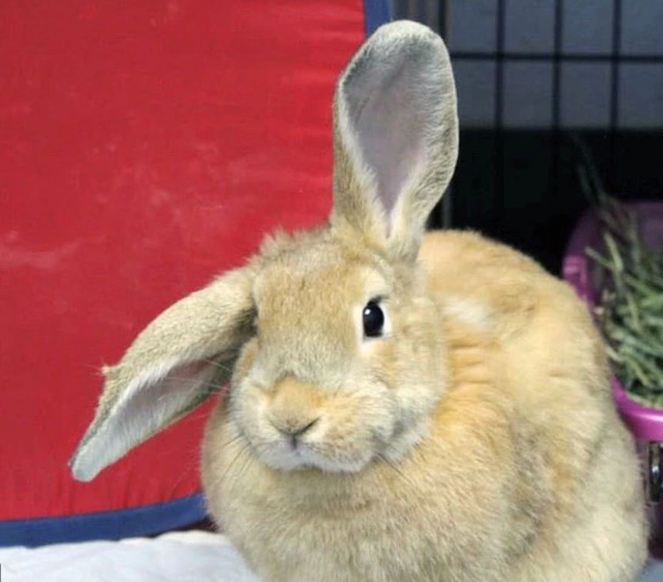





9 Specific Tile
←
…
Need:
Dog Icon
Cat Icon
“Other” Icon
Can be the same as before?
SPCA Cincinnati
Animal Shelter · Cats, Dogs, Others
Volunteers OK
Donations Needed
Dogs
Missy
Pebbles
Thor
Sir Nicholas
Scout
Q
Cats
Kittie
Rosa
Tigre
Nicole
Miss Prowl
A
Others
Search
Favorites
More
Me
Swipe Mode
Favorites
Swipe Mode

Slide 2



9 Specific Tile
←
SPCA Cincinnati
…
Others
Zack
Squirt
125 Wallaway St., Cincinnati, Ohio
Monday – Friday | 9 AM – 12 PM 2:30 PM – 6 PM
Saturday | 11 AM – 4 PM
Sunday | Closed
Volunteers OK
Here’s what the organization says:
Please attend one of our 2-hour orientation sessions listed on our website. Volunteers can participate in the following activities:
Clean cages
Socialize the cats
See more
Not in Need of Donations
Search
Me
Swipe Mode
Favorites
More
Swipe Mode

Slide 3
9.1 Example of Donations Needed box
←
SPCA Cincinnati
…
Volunteers OK
Here’s what the organization says:
Please attend one of our 2-hour orientation sessions listed on our website. Volunteers can participate in the following activities:
Clean cages
Socialize the cats
See more
In Need of Donations
Blankets
Toys
Purine Soft Puppy Food
Lysol Spray
Clorox Wipes
Clorox Wipes
See more
Search
Me
Swipe Mode
Favorites
More
Swipe Mode

Slide 4
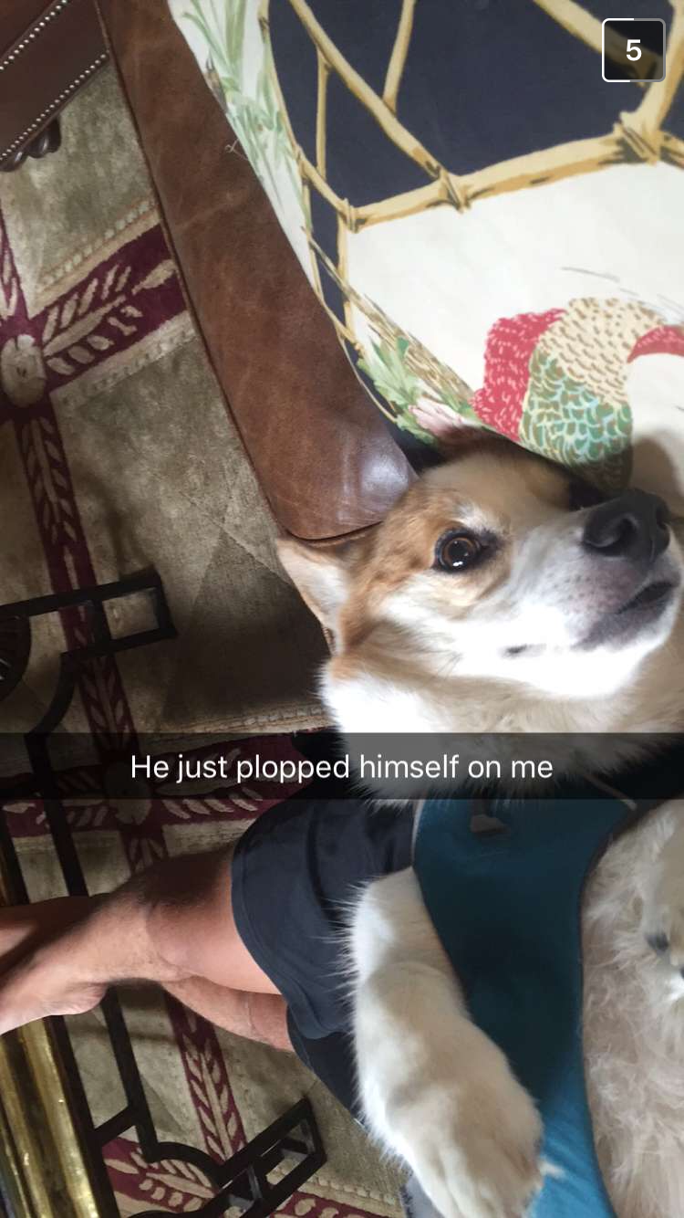
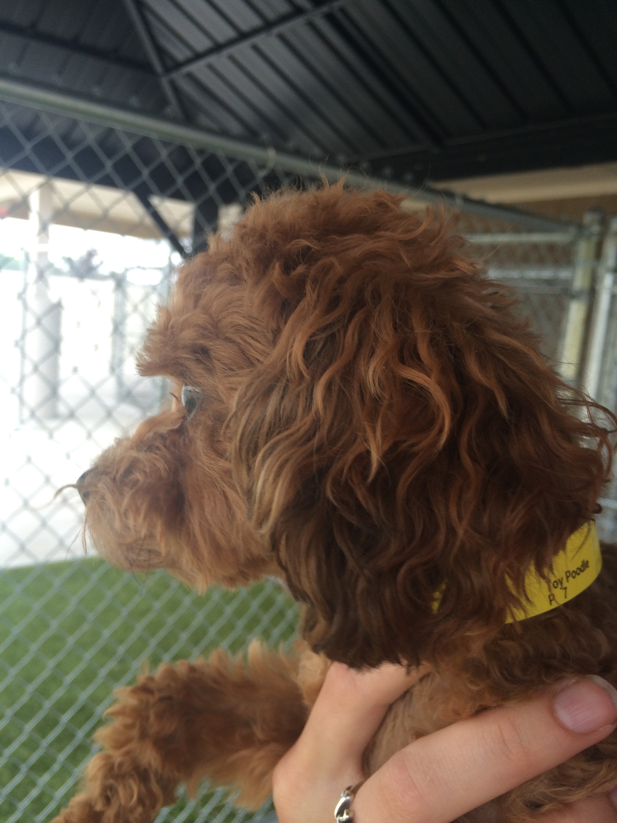
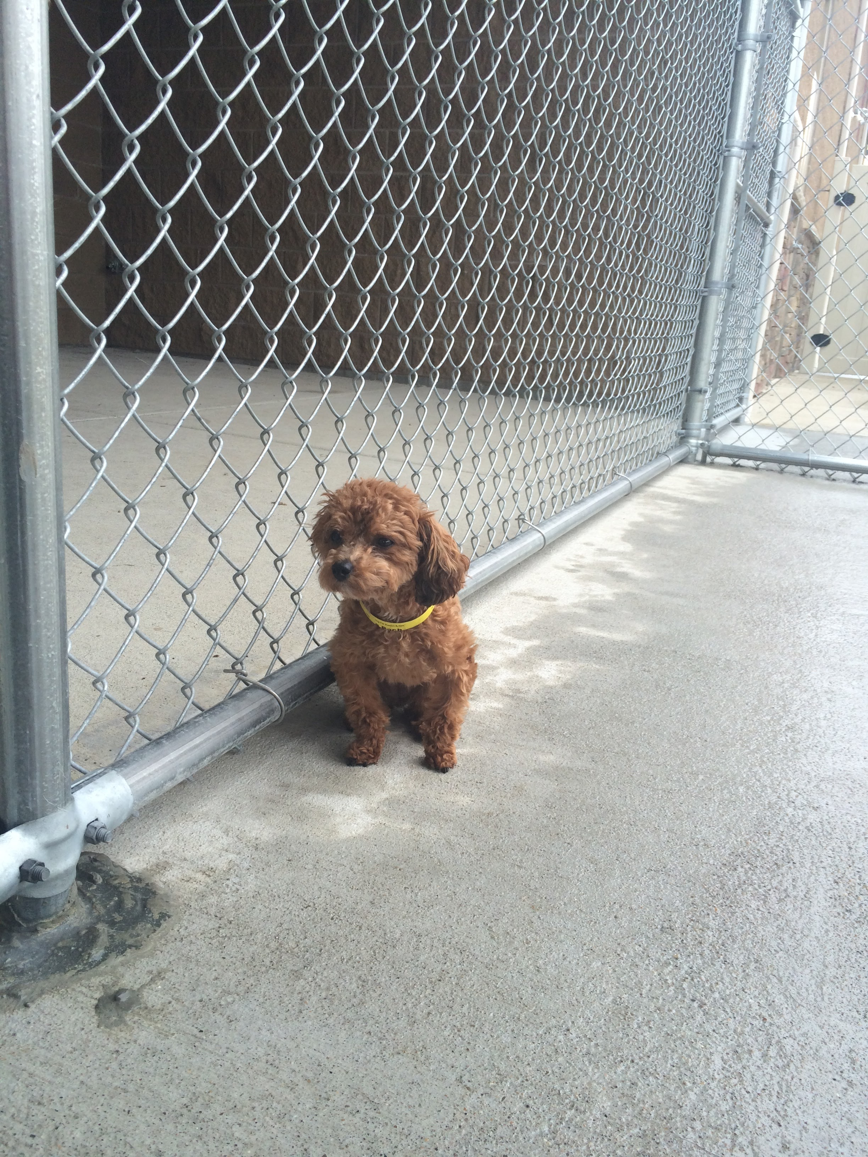
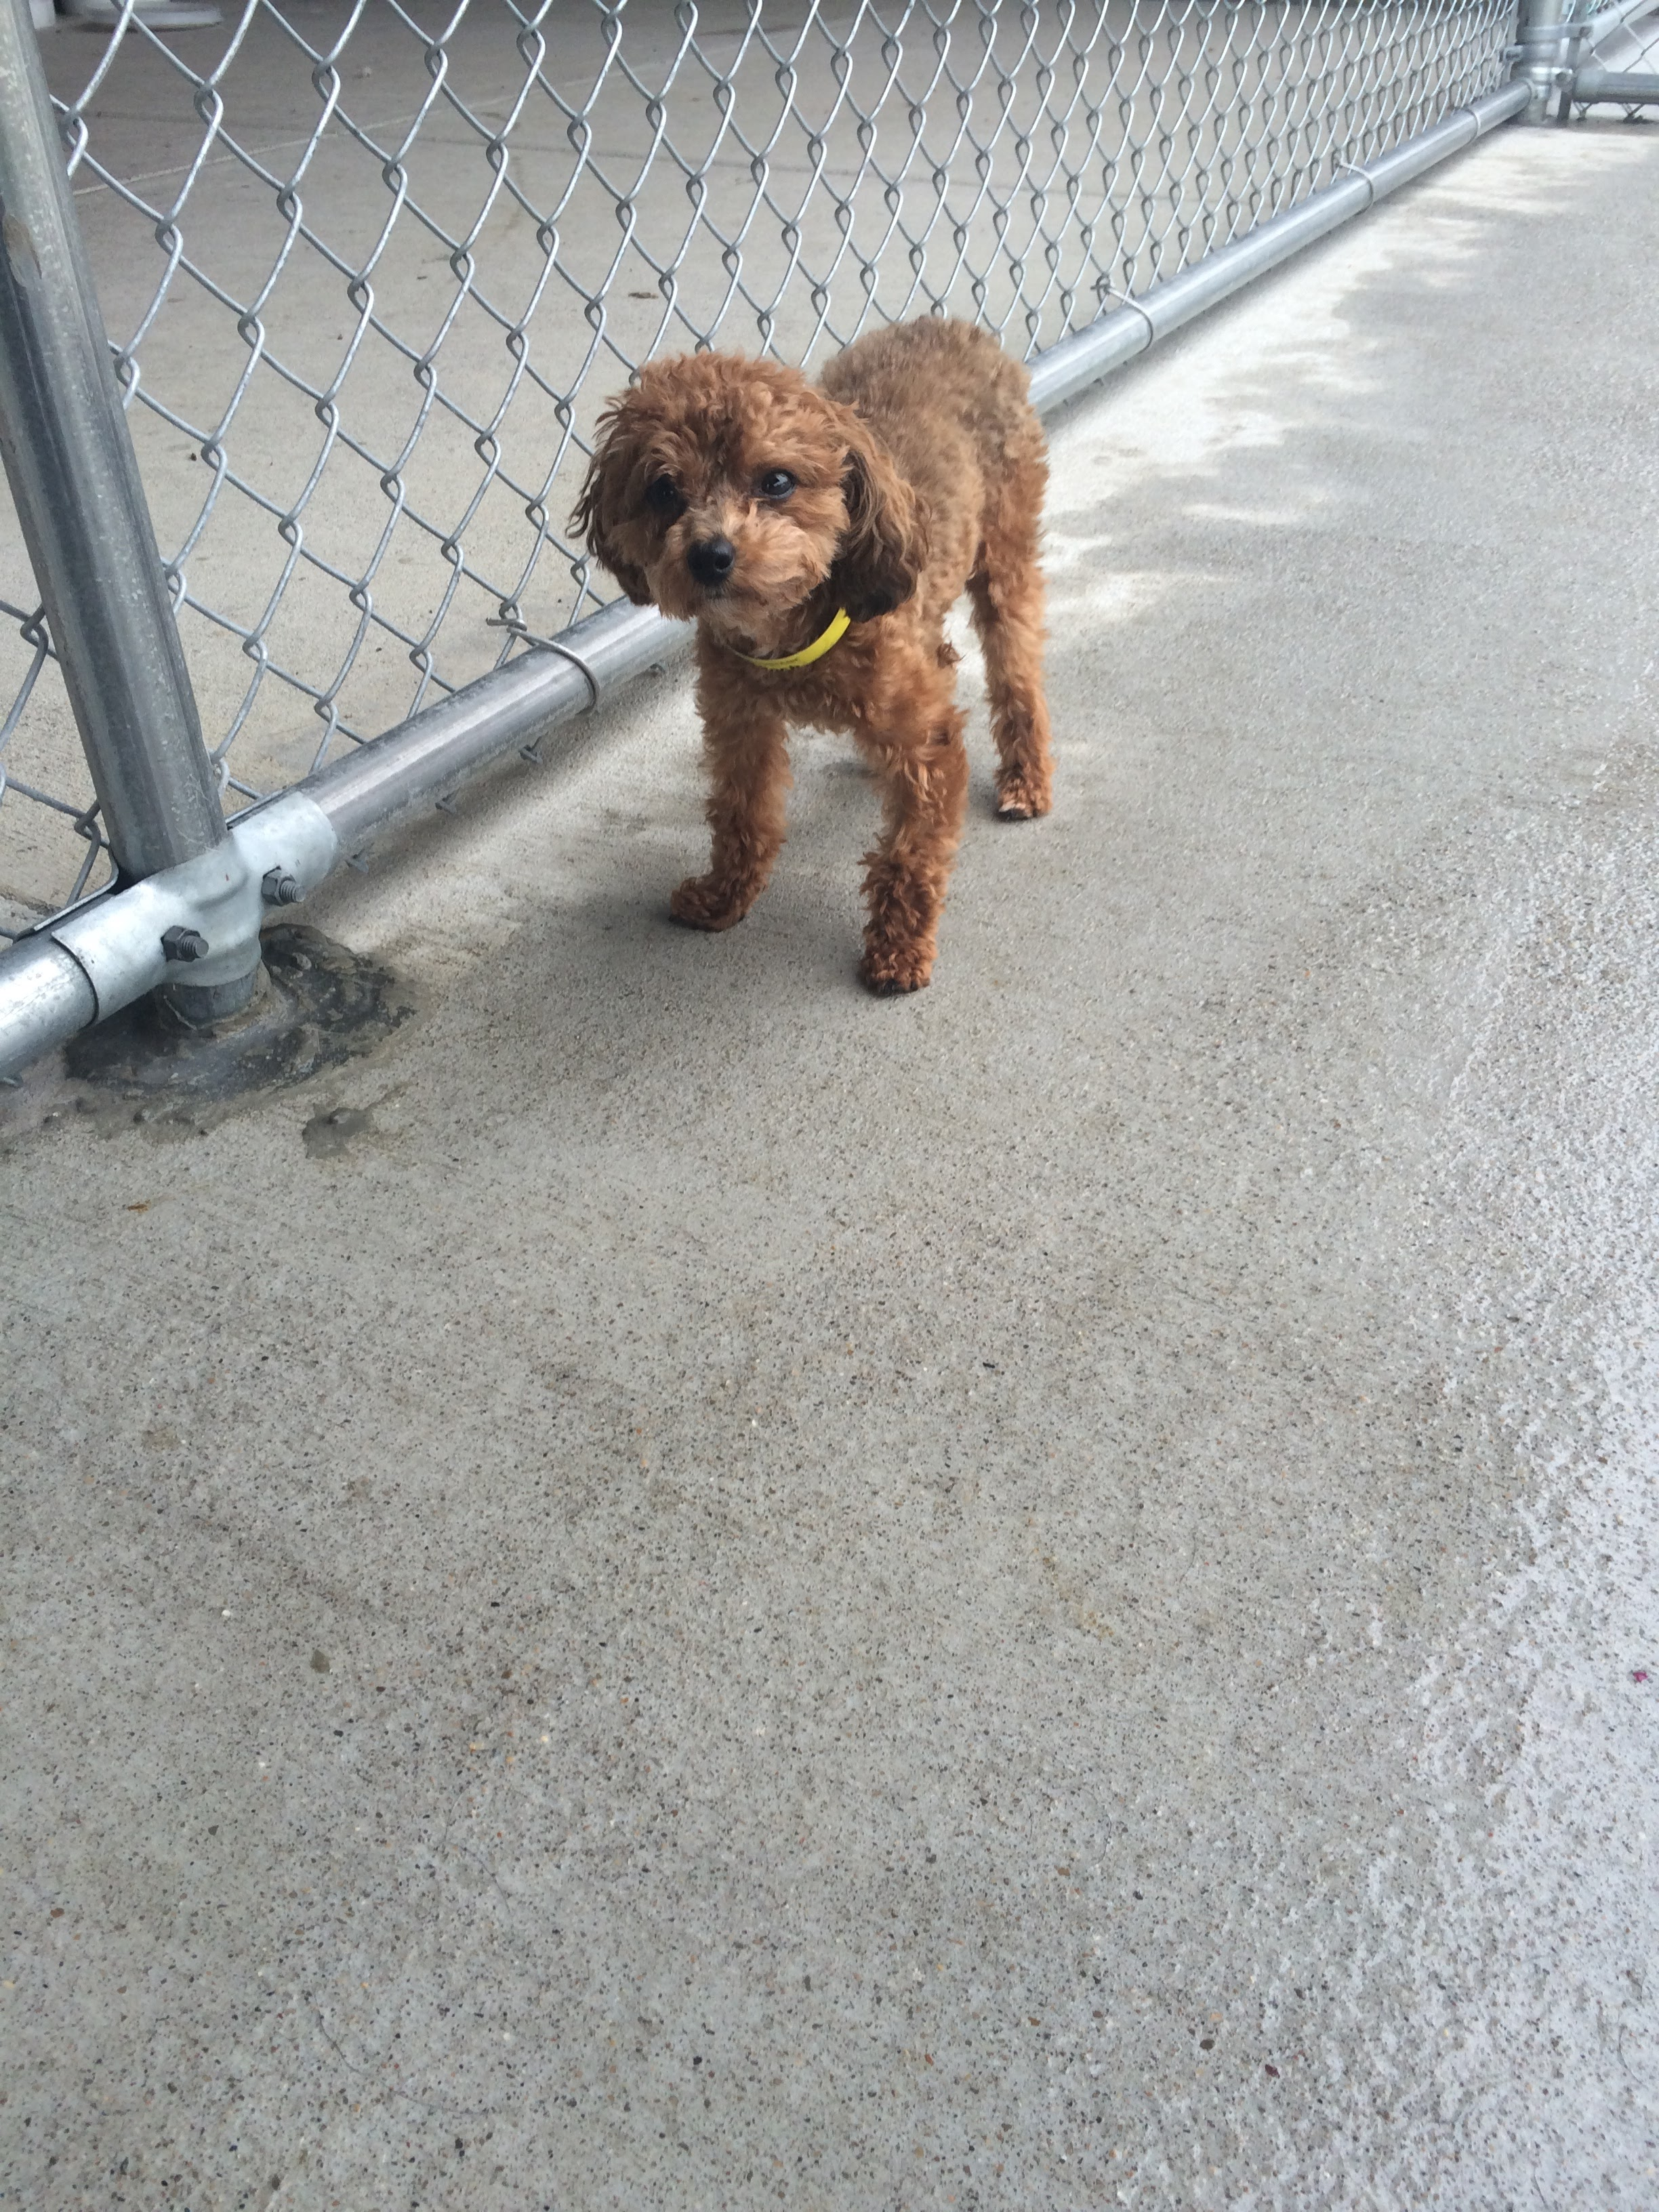
What happens if they click Dogs/Cats/Other
←
SPCA Cincinnati
…
Breed
Age
Color
Gender
Tags
Dogs
Missy Corgi Mix, Female, 4 y/o
→
See all
Comments
“Missy was super playful and loved to go on walks!”
“Only dog I’ve met who likes to lick your hand! So cute!!”
“Not a big fan of toys – she just ignored everything that I threw her way”
See more
Thor Toy Poodle, Male, 6 y/o
→
See all
Comments
“Thor is the fluffiest thing I’ve ever touched”
“SUCH a cuddler!!! Perfect for anyone feeling lonely”
“Not a big fan of walking, but he likes to play!”
See more
Pebbles Dalmatian Mix, Male, 2 y/o
Search
Me
Swipe Mode
Favorites
More

Slide 5
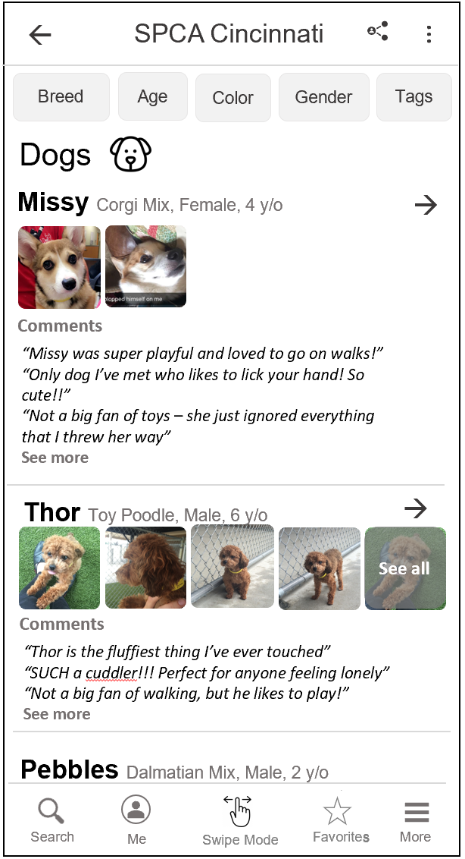
What happens if they click the … (more options)
Write a comment
Add photo or video
Send feedback
Share pet
*Allow user to add content on this page as well (instead of only on the animal’s specific page )
Should it be “Add content” or two separate options for “Add photo/video” and “Add comment” ?

Slide 6

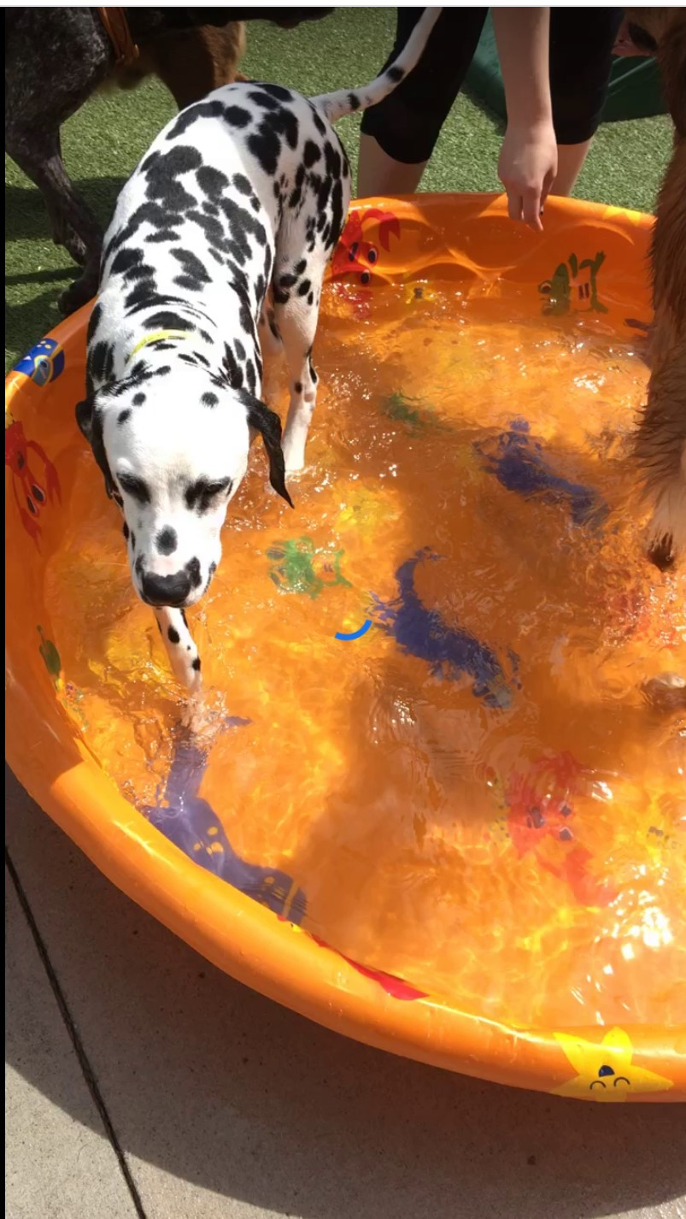
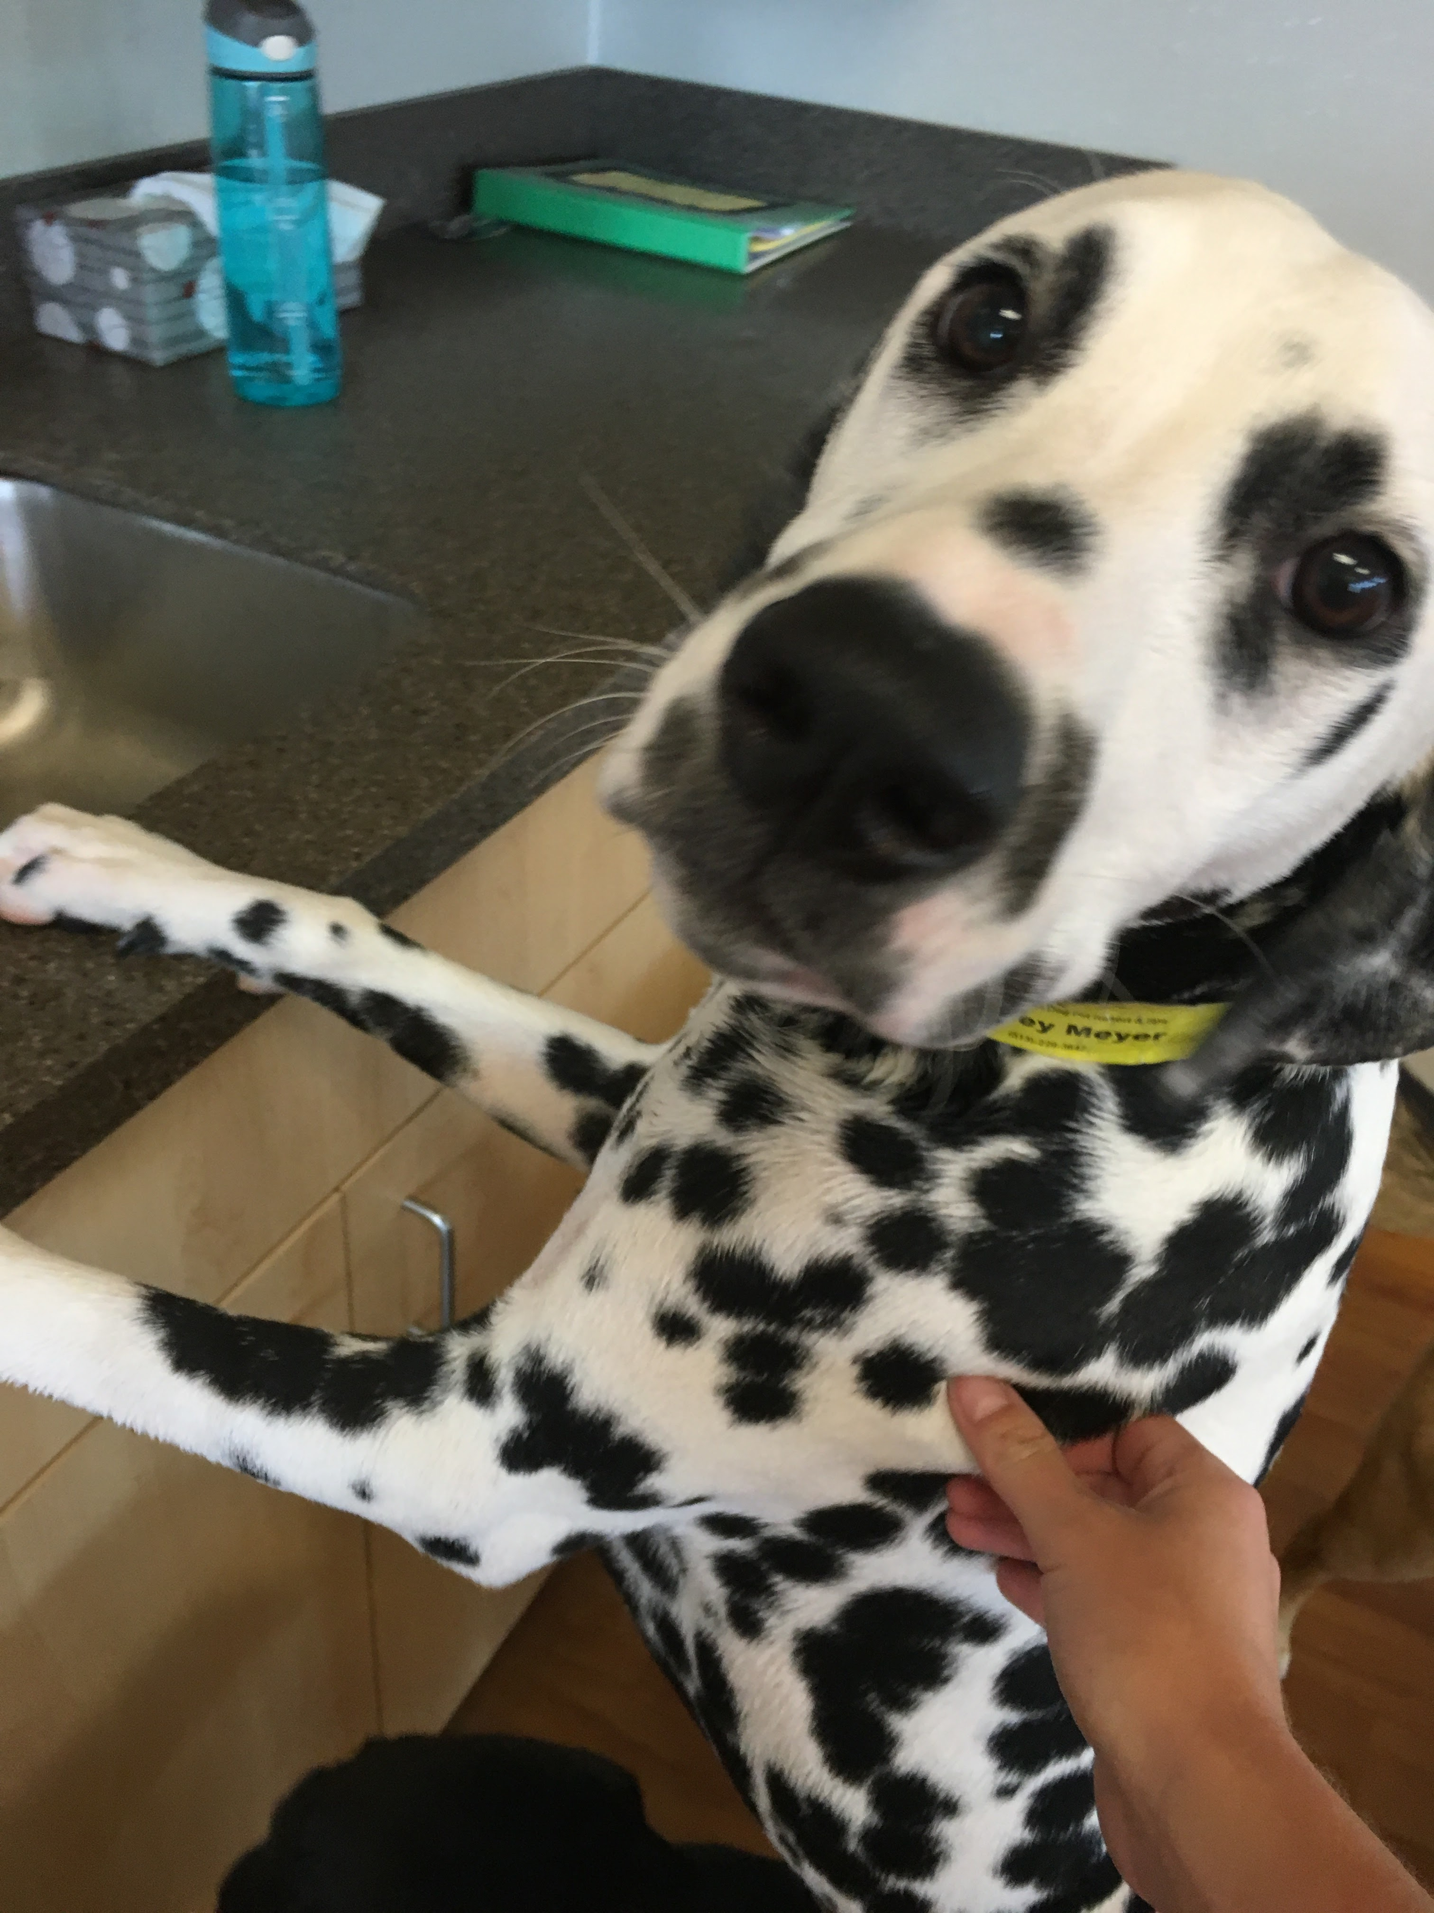
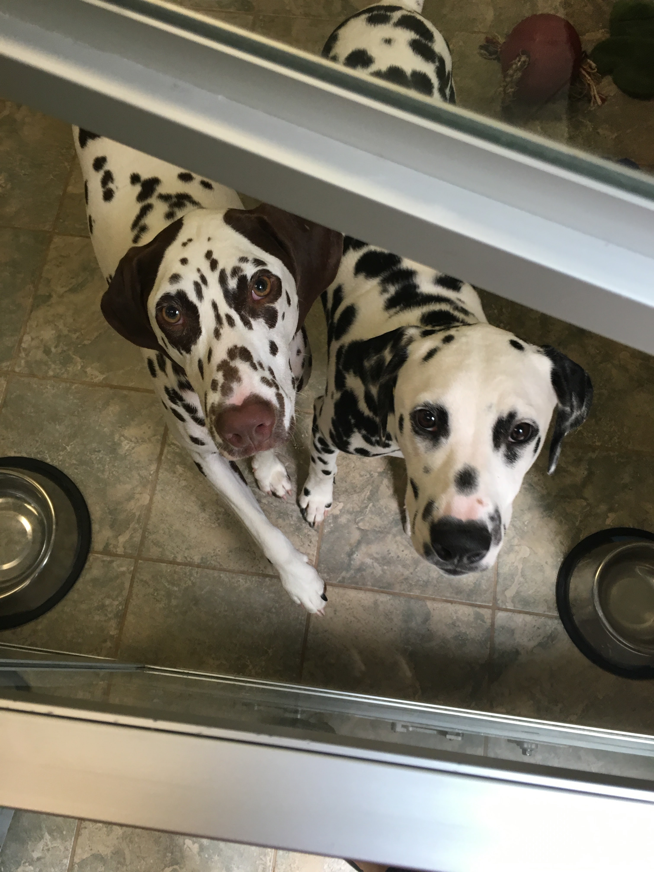
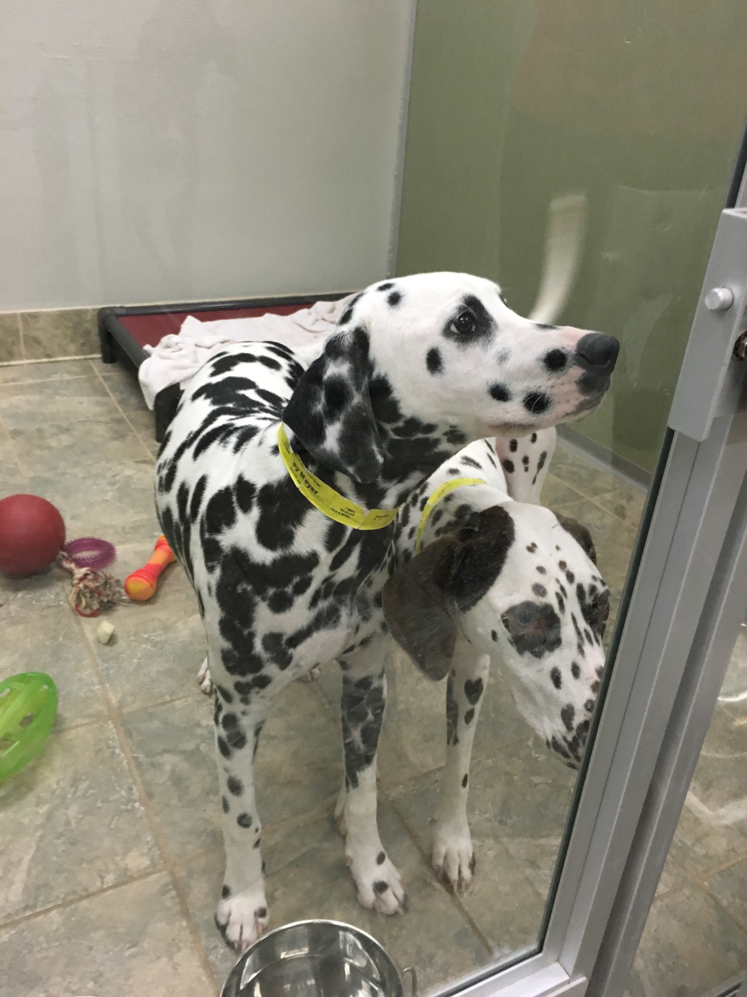
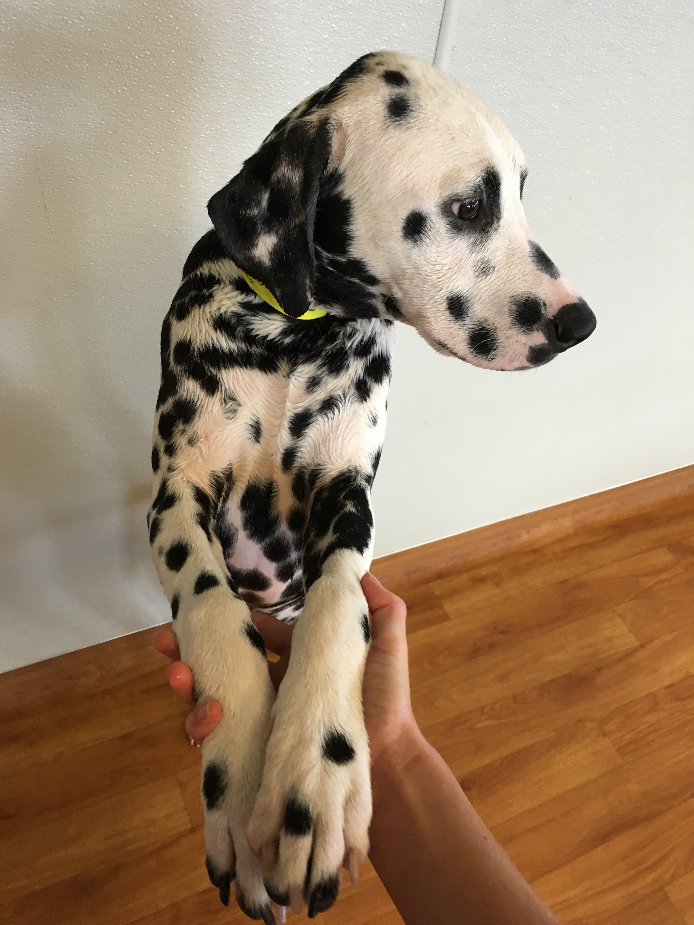
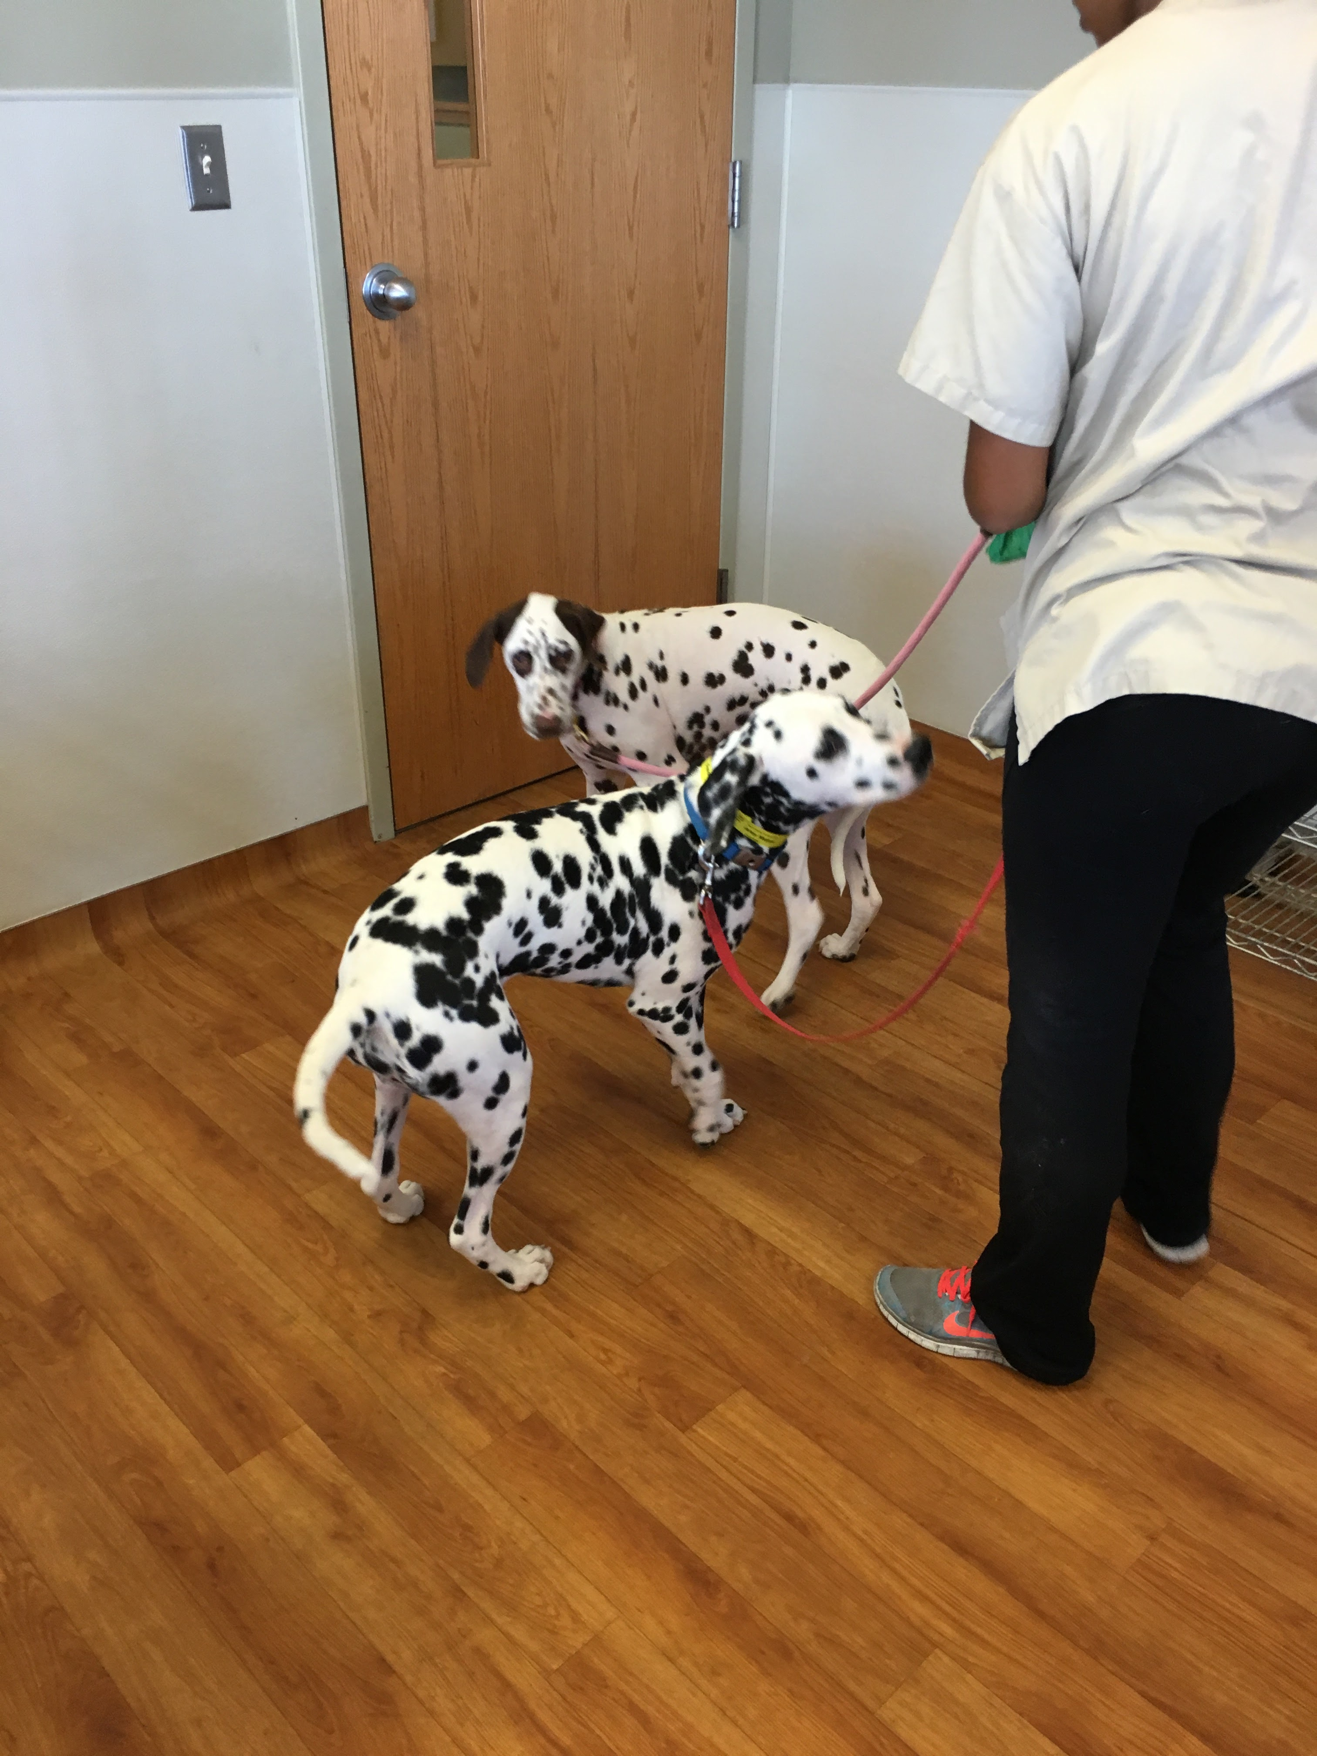

What happens if they click on a specific dog
←
SPCA Cincinnati
…
Speckles Dalmatian Mix, Male, 2 y/o
Clicking on “SPCA Cincinnati” brings them back to their home page
They can tap on the star to add the dog to favorites
See all
See all
Just have them keep scrolling to see all the comments, allow a filter for keywords (one at a time)
Click on three dots to see *Add photo* or *Add comment*
Comments
+
4/12/2020
Speckles was super playful and loved to go on walks!
3/18/2020
Speckles is still young and definitely likes to wrestle with you – be careful with small children!
Search
Me
Swipe Mode
Favorites
More

Slide 7
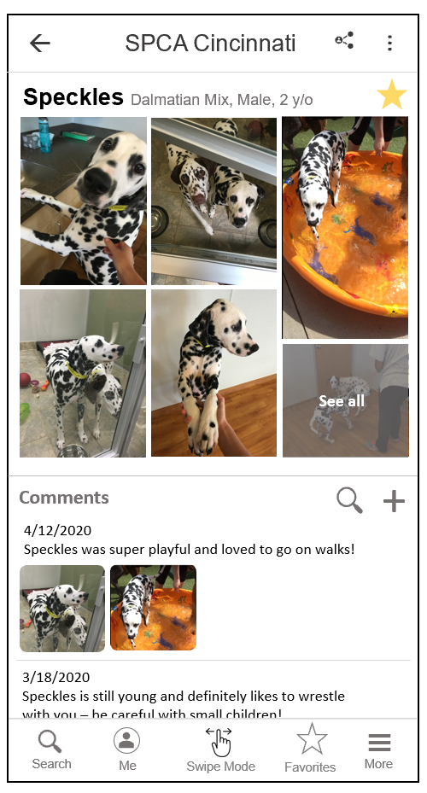
What happens if they click on the …
Write a comment
Add photo or video
Send feedback
Share pet
Click on three dots to see *Add photo* or *Add comment*
Should I keep them together or separate? Same issue as before

Slide 8









Write a comment
Write a comment for
X
Pebbles
Please write about your experience with Pebbles. This information will help us match these adorable furry friends with their forever homes.
Pebbles
Arthur
Chewy
Misty
Pebbles
Rocky
Sir Nicolas
Sparky
Zoomer
Add New Pet
POST COMMENT

Slide 9
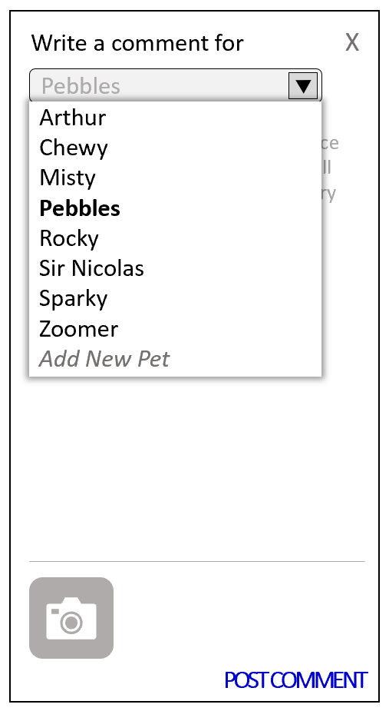
Add a new pet
Add New Pet
My name is…
Thank you for your contribution!
This comment will be sent to the shelter for review, where more information will be added.
Add

Slide 10
Formatting of photos and videos (mimic Google Photos)
←
Photos and Videos
+
Speckles Dalmatian Mix, Male, 2 y/o
Clicking on “SPCA Cincinnati” brings them back to their home page
Just have them keep scrolling to see all the comments, allow a filter for keywords?
When they click on an individual photo, they’ll be presented to horizontal scroll mode, with the option to scroll up and see the comment associated with it.
Speckles was super playful and loved …
See all
Search
Favorites
More
Me
Swipe Mode
Favorites
Swipe Mode

Slide 11



When User clicks to add Photo/Video
X
Add Photo and/or Videos
Next (1)
Camera roll #1
Take Photo
Take Video
** directly on the photos screen !!
Camera roll
Camera roll
Camera roll
When no options are clicked: Next (0)
Camera roll
Camera roll
Camera roll
Camera roll
Camera roll
Camera roll
Camera roll
Camera roll
Camera roll

